Slide 1
The Enhanced ER model (EER)
Chapter 4

Slide 2
Introduction
The databases as CAD/CAM, telecommunications, complex software systems, GIS (global information system), etc.. have more complex requirements.
This lead to the development of additional semantic data modeling concepts that were incorporated into conceptual data models such as the ER model.
The ER model can be enhanced to include the features that have been proposed for semantic data models, leading to the enhanced ER (EER) model.

Slide 3
Cont’d
The EER model includes all the modeling concepts of the ER model.
In addition, it includes the concepts of subclass & super class and the related concepts of specialization & generalization.
The diagrammatic technique for displaying these concepts in EER schema is called enhanced ER or EER diagrams.

Slide 4
Subclasses, Super classes & Inheritance

Slide 5
Cont’d
In ER modeling, an entity type is used to represent both a type of entity and the entity set (collection of entities of that type) that exists in the database.
In many cases, An entity type may have additional meaningful subgroupings of its entities.
And it needs to be represented explicitly because of their significance for database application.

Slide 6
Cont’d
Example: EMPLOYEE may be further grouped into:
SECRETARY, ENGINEER, TECHNICIAN (Based on the EMPLOYEE’s Job)
MANAGER ( based on the role they play)
SALARIED_ EMPLOYEE and HOURLY_EMPLOYEE (based on method of pay)
Every entity that is a member of these sub groupings is also an employee.
These sub groupings are called as a subclass of the EMPLOYEE entity type and the EMPLOYEE entity type is called the superclass for each of these subclasses.

Slide 7
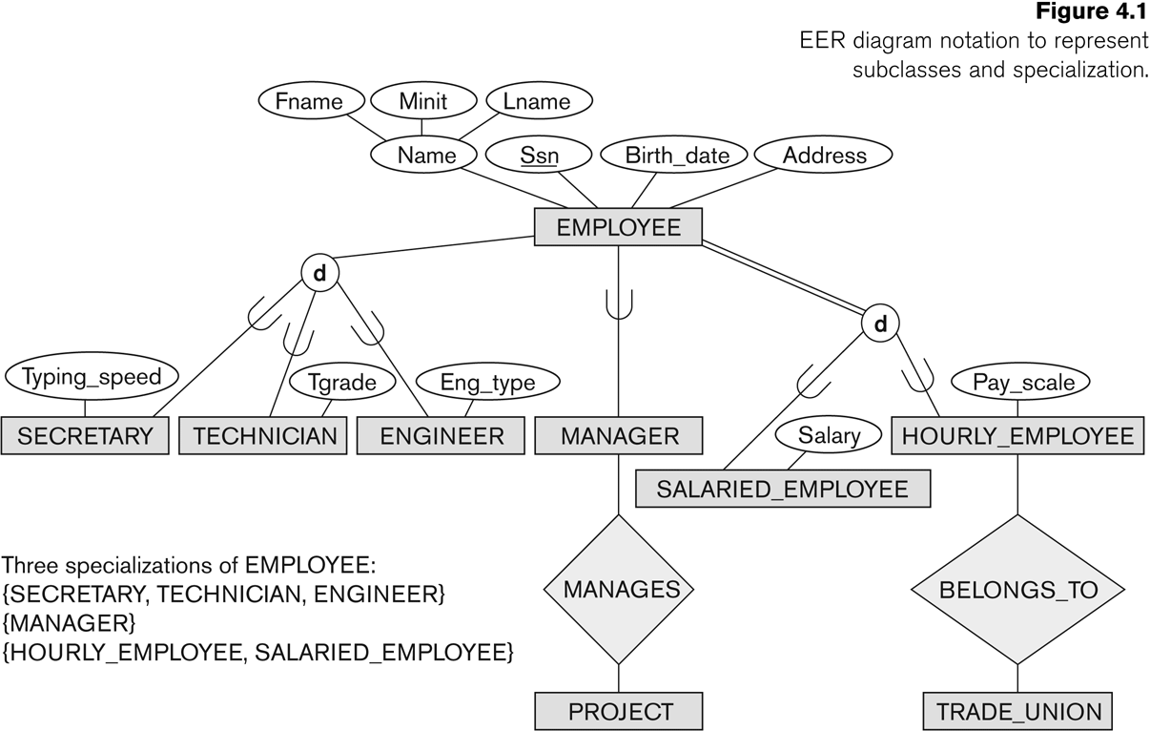
The figure below shows how these concepts are diagrammatically represented in EER diagrams.

Slide 8
Cont’d
The relationship between a superclass and any one of its subclasses is called as a class/subclass relationships or IS-A relationships.
It is said that SECRETARY is an EMPLOYEE, a TECHNICIAN is an EMPLOYEE, etc…….
A member entity of the subclass represents the same real world entity as some member of the superclass.
For eg: a SECRETARY entity, say ‘Mary Smith’ is also the EMPLOYEE ‘Mary Smith’.
Hence the subclass member is the same as the entity in the super class, but in a distinct specific role.

Slide 9
Cont’d
An entity cannot exist in the database merely by being a member of a subclass; it must also be a member of the super class.
Such an entity can be included optionally as a member any number of subclasses.
Example: A salaried employee who is an engineer belongs to the two subclasses ENGINEER and SALARIED_EMPLOYEE of the EMPLOYEE entity type.
However, it is not necessary that every entity in a super class should be a member of some subclasses.

Slide 10
Type Inheritance
An important concept associated with subclasses is that of type inheritance.
Since, an entity in the subclass represents the same real-world entity from the super class, it should possess values for its specific attributes.
An entity that is a member of a subclass inherits all the attributes of the entity as the member of the super class.
Also, it inherits all the relationships in which the super class participates.
In the previous slide, SECRETARY (as well as TECHNICIAN and ENGINEER) inherit the attributes Name, SSN, …, from EMPLOYEE

Slide 11
Specialization & Generalization

Slide 12
Specialization
Specialization is the process of defining a set of subclasses of an entity type or superclass.
The set of subclasses that forms a specialization is defined on the basis of some distinguishing characteristics.
Example 1: the set of subclasses { SECRETARY, ENGINEER, TECHNICIAN} is a specialization of the superclass EMPLOYEE that distinguishes among employee entities based on the job_type of each employee entity.
There can have several specializations of the same entity type, based on different distinguishing characteristics.
Example2: MANAGER is a specialization of EMPLOYEE based on the role the employee plays.

Slide 13
Cont’d
Example3: the subclasses {SALARIED_EMPLOYEE, HOURLY_EMPLOYEE} is a specialization of the superclass EMPLOYEE entity type based on the method of pay.
Superclass/subclass relationships and specialization can be diagrammatically represented in EER diagrams.
Attributes of a subclass are called specific or local attributes.
For example, the attribute Typing Speed of SECRETARY
The subclass can also participate in specific relationship types.
For example, a relationship BELONGS_TO of HOURLY_EMPLOYEE

Slide 14
The subclasses that define a specialization are attached by lines to a circle that represents the specialization , which is connected to the super class as shown in the EER diagram below.

Slide 15
Cont’d
The attributes that apply only to entities of a particular subclass are called specific attributes or local attributes.
Similarly, a subclass can participate in specific relationship types also (as shown in the figure above).
In summary, the specialization process allows us to do the following
Define a set of subclasses of an entity type
Establish additional specific attributes with each subclass
Establish additional specific relationship types between each subclass and other entity types or other subclasses.

Slide 16
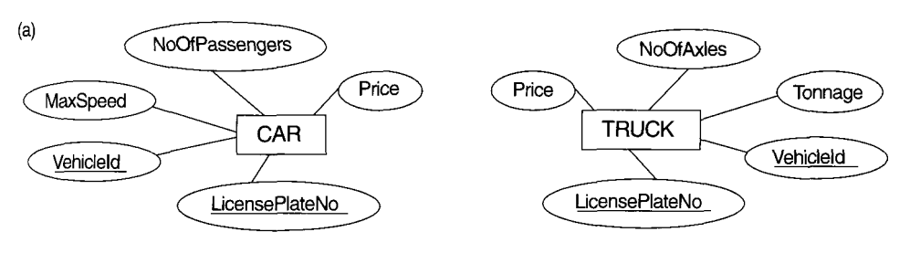
Generalization
Generalization is the reverse of the specialization process.
Several classes with common features are generalized into a superclass.
Example: CAR, TRUCK generalized into VEHICLE;
both CAR, TRUCK become subclasses of the superclass VEHICLE.
We can view {CAR, TRUCK} as a specialization of VEHICLE
Alternatively, we can view VEHICLE as a generalization of CAR and TRUCK

Slide 17
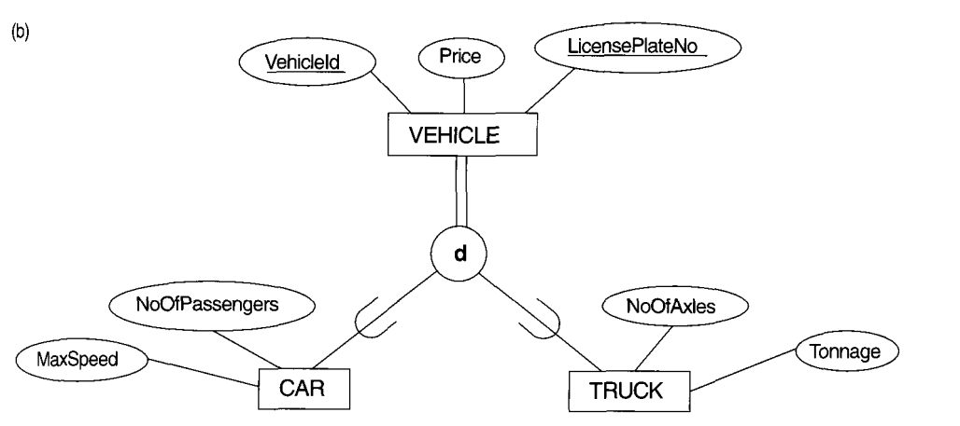
Since both the entity types are having several common attributes, they can be generalized into the entity type VEHICLE, as shown in below diagram.
Both CAR and TRUCK entities are now subclasses of the generalized superclass VEHICLE.

Slide 18
Notice that generalization process can be viewed as being functionally the inverse of the specialization process.
Hence, in the above figure, it can be viewed {CAR, TRUCK} as a specialization of VEHICLE, rather than viewing VEHICLE as a generalization of CAR and TRUCK.
Similarly, from the previous example, EMPLOYEE can be viewed as a generalization of SECRETARY, TECHNICIAN and ENGINEER.
A diagrammatic notation (normally an arrow)to distinguish between generalization and specialization is used in some design methodologies, but the decision as to which process more appropriate in a particular situation is often subjective.

Slide 19
Constraints on Specialization & Generalization
Basic constraints can apply to a specialization/ generalization:
Membership constraints:(user defined and attribute defined)
Disjointness Constraint: (disjoint and overlap)
Completeness Constraint: (total and partial)

Slide 20
Membership constraints
In general, there may have several specialization defined on the same entity type (or super class) as shown in the diagram below.
Predicate-defined ( or condition-defined) : based on some predicate. E.g., based on value of an attribute, payment, Job-type, or Age.
Attribute-defined: shows the name of the attribute next to the line drawn from the superclass toward the subclasses.
User-defined: membership is defined by the user on an entity by entity basis

Slide 21
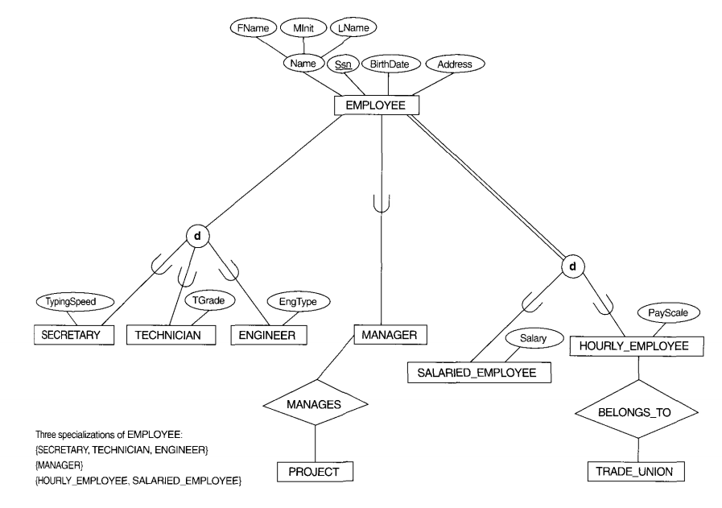
Cont’d

Slide 22
Cont’d
However, a specialization may also consist of a single subclass only, such as the {MANAGER} specialization in the figure above.
In such situations, the circle notation will not be used (refer the diagram above).
In some specialization, it is possible to determine exactly the entities that will become members of each subclass by placing a condition on the value of some attribute of the superclass.
Such subclasses are called predicate-defined (or condition-defined) subclasses. For eg: consider the following diagram.

Slide 23
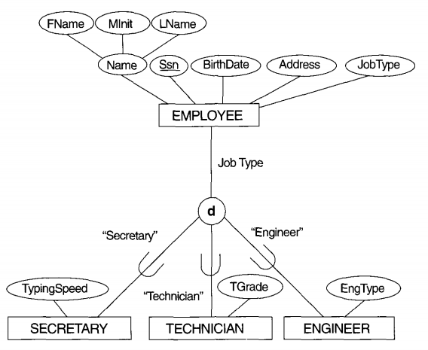
Cont’d

Slide 24
The EMPLOYEE entity type has an attribute Job_type.
We can specify the membership in the SECRETARY subclass, by the condition (Job_type= ‘Secretary’), which we call the defining predicate of the subclass.
This condition is a constraint specifying that, exactly those entities of the EMPLOYEE entity type, whose attribute values for Job_type is ‘Secretary’, belong to the subclass SECRETARY.

Slide 25
A predicate_defined subclass is displayed by writing the predicate condition next to the line that connects the subclass to the specialization circle.
If all subclasses in a specialization have their membership condition on the same attribute of the superclass, the specialization itself is called an attribute_defined specialization.
Example: JobType is the defining attribute of the specialization {SECRETARY, TECHNICIAN, ENGINEER} of EMPLOYEE.
When there is no condition for determining membership in a subclass, the subclass is called user_defined subclass.

Slide 26
Disjointness constraint
Disjoint constraint, which specifies that the subclass of the specialization must be disjoint.
This means that an entity can be a member of atmost one of the subclasses of the specialization.
A specialization that is attribute_defined implies the disjointness constraint if the attribute used to define the membership predicate is single-valued.
This case is represented as d enclosed in a circle (refer the above diagram).
The same notation is also used to specify the constraint that user_defined subclasses of a specialization, which must be disjoint.

Slide 27
Cont’d
If the subclasses are not constrained to be disjoint, their sets of entities may overlap; i.e, the same entity may be a member of more than one subclass of the specialization.
If not disjoint, specialization is overlapping:
This case is displayed by placing a o in the circle as shown in the below diagram.

Slide 28
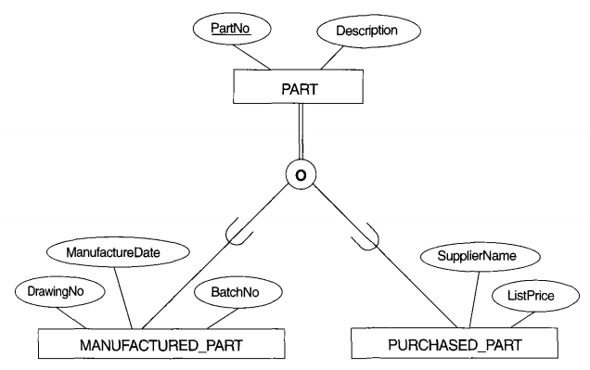
Cont’d

Slide 29
Completeness constraint
The other constraint on specialization is called the completeness constraint, which may be total or partial.
A total specialization constraint specifies that every entity in the super class must be a member of at least one subclass in the specialization.
For eg: if every EMPLOYEE must be either an HOURLY_EMPLOYEE or a SALARIED_EMPLOYEE, then the specialization {HOURLY_EMPLOYEE, SALARIED_EMPLOYEE} of the below given figure is a total specialization of EMPLOYEE.
This is shown in EER diagrams by double line to connect the super class to the circle.
A single line is used to display a partial specialization, which shows an entity may not belong to any of the subclasses.
For eg: if some EMPLOYEE entities do not belong to any of the subclasses {SECRETARY, ENGINEER, TECHNICIAN} of the following figure, then that specialization is partial.

Slide 30
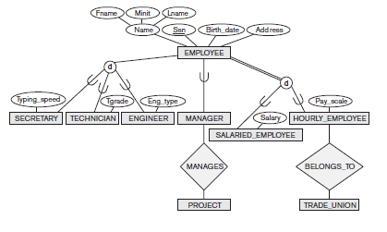
Cont’d

Slide 31
Notice that disjointness and completeness constraints are independent.
Hence, we have the following four possible constraints on specialization.
Disjoint, total
Disjoint, partial
Overlapping, total
Overlapping, partial

Slide 32
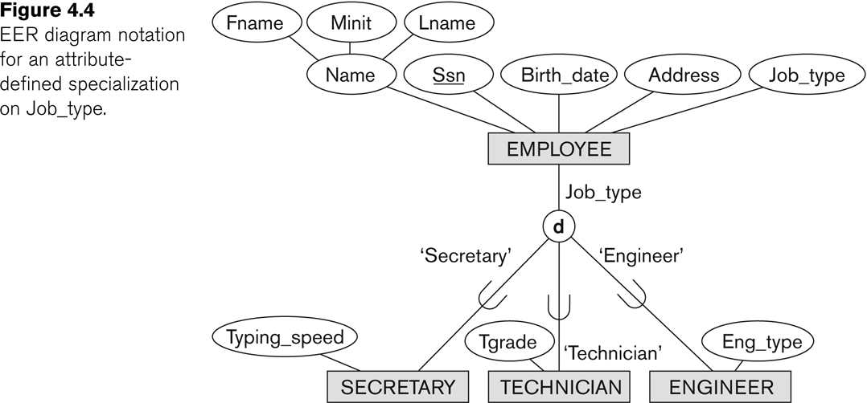
Example of disjoint partial Specialization

Slide 33
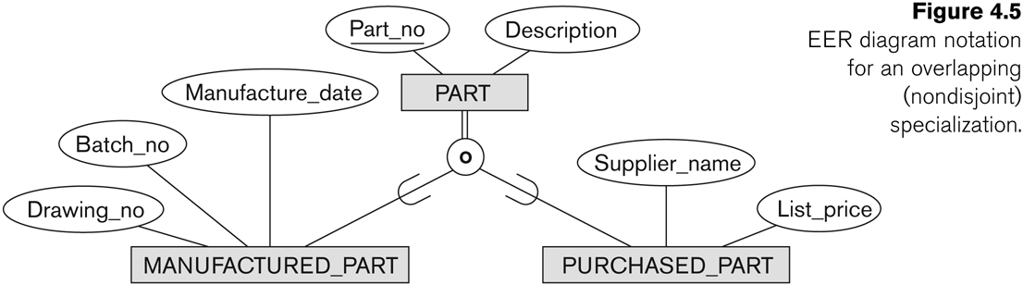
Example of overlapping total Specialization

Slide 34
Certain insertion and deletion rules apply to specialization (and generalization) as a consequence of the constraints specified earlier.
Some of the rules are as follows;
Deleting an entity from a super class implies that it is automatically deleted from all the subclasses to which it belongs.
Inserting an entity in a super class implies that the entity is mandatorily inserted in all predicate_defined (or attribute_defined) subclasses for which the entity satisfies the defining predicate.
Inserting an entity in a super class of a total specialization implies that the entity is mandatorily inserted in atleast one of the subclasses of the specialization.

Slide 35
Thank You!!!!

